Slide 1
DV Resources
Bobbianne Elizabeth

Slide 2
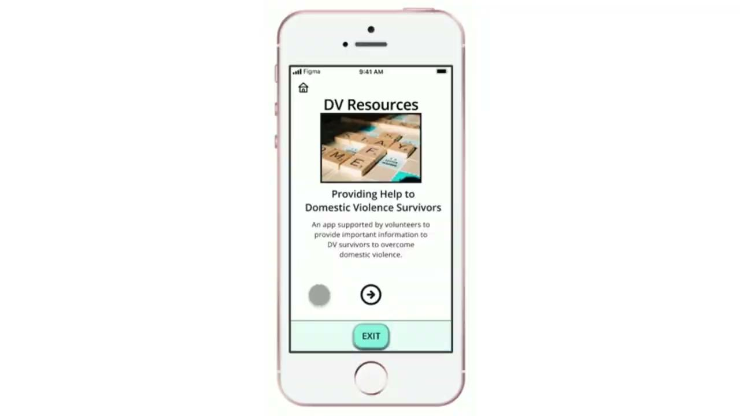
Project overview
The product:
Domestic Violence survivors need a multitude of resources to escape abusive relationships. In effort to make this huge amount of information accessible and easy to access, the app and responsive website DV Resources was created.
Project duration:
Summer 2022

Slide 3
Project overview
The problem:
The problem is that resources from local and national agencies are disparate. Currently, there is no app/website that houses the multitude of domestic violence (DV) resources in one place.
The goal:
Create a simple, easy to navigate app and a responsive website that contains a multitude of DV resources in one place so survivors can focus on using resources versus finding resources.

Slide 4
Project overview
My role:
Lead UX Designer, Lead UX Researcher, and Website Developer
Responsibilities:
User Research, Ideate, Code, Wireframing, Prototyping in multiple formats, Design and Creation of Website

Slide 5
User research
Personas
Problem statements
Competitive audit
Ideation
Understanding
the user

Slide 6
User research: summary
By conducting a series of interviews, surveys, and reading available research papers, I discovered how few apps or websites contained information that was easy to use. Survivors in a crisis state and need information to be quickly digestible. Working with trauma survivors as an artist and being a domestic violence survivor myself, I was aware of the need for resources. However, half of the battle was just to find the resources. Most of the resources in this app/website I discovered in a multi-year journey overcoming domestic violence. In addition to interviewing fellow survivors, my competitive audit found that most apps where only for safety plan (the first step of leaving a DV relationship). None of the app contained all the needed resources needed to escape domestic violence.

Slide 7
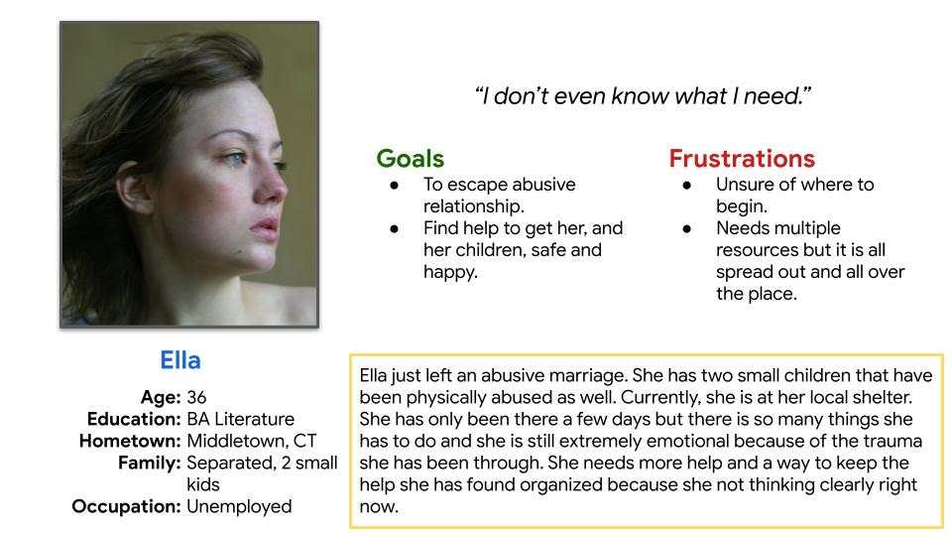
Persona 1: Ella
Problem statement:
Ella is a domestic violence survivor who needs an app or website that contains multiple resource that are saved & organized because she is traumatized right now and not thinking clearly.

Slide 8
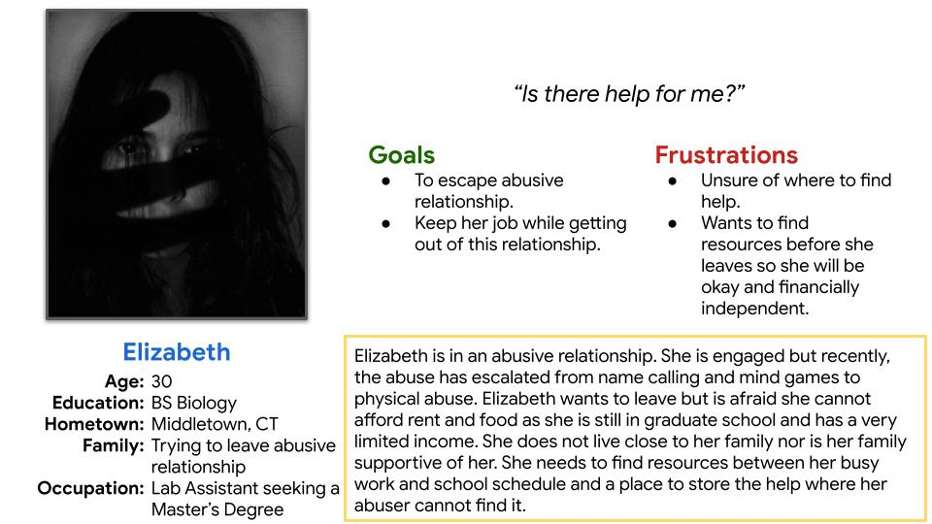
Persona 2: Elizabeth
Problem statement:
Elizabeth is experiencing domestic violence. She needs an app or website with resources on how to leave the relationship and save that information so the abuser does not find it because she is trying to leave the relationship.

Slide 9
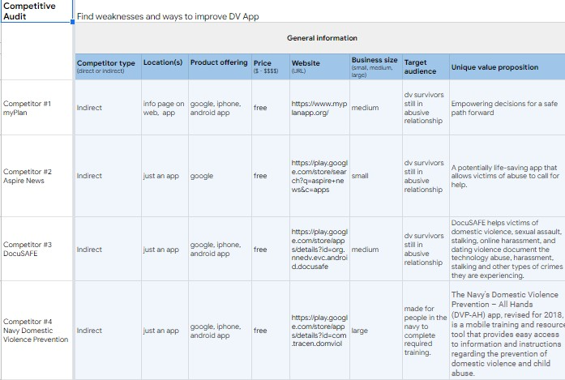
Competitive
Audit
There are 4 apps that were the most used. All were either about safety planning or prevention. None helped people go through or overcome the DV process.

Slide 10
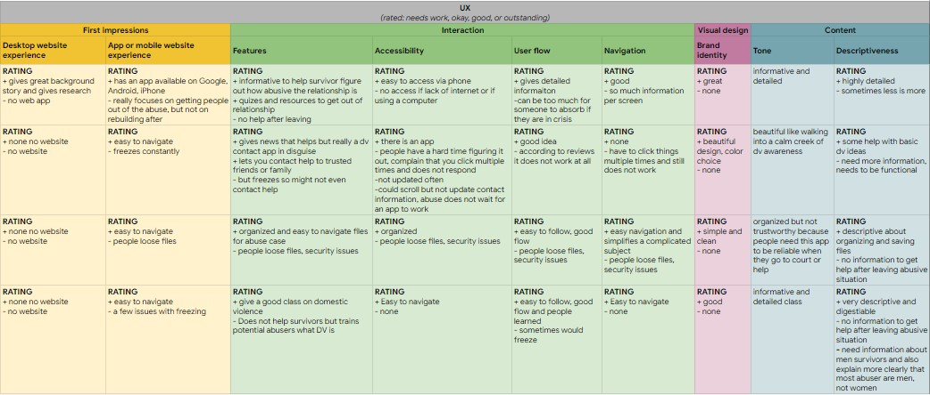
Competitive
Audit
Most apps had nice designs but where not well-maintained nor did the help survivors find more help than to just “leave” the relationship.

Slide 11
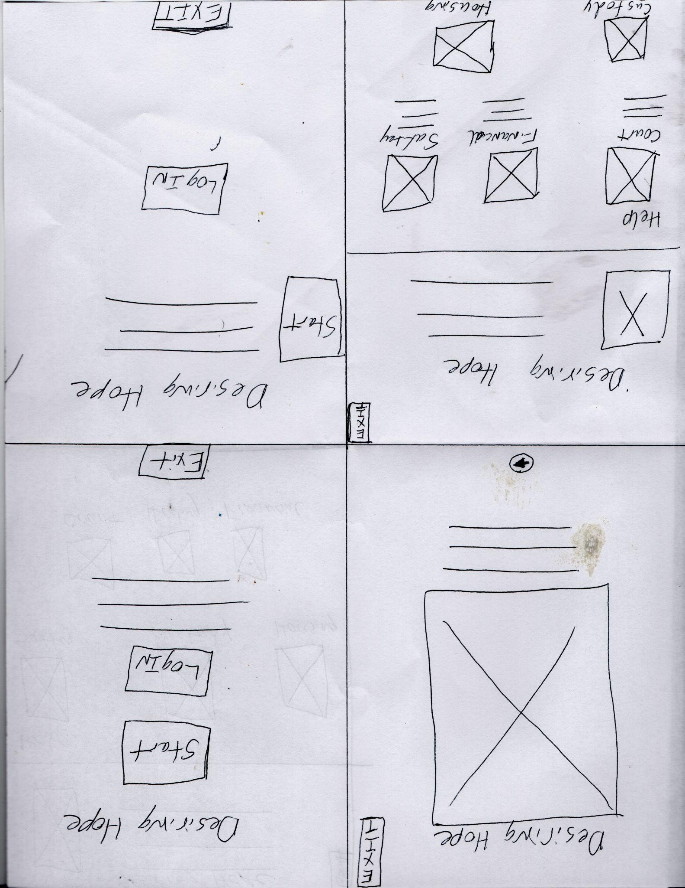
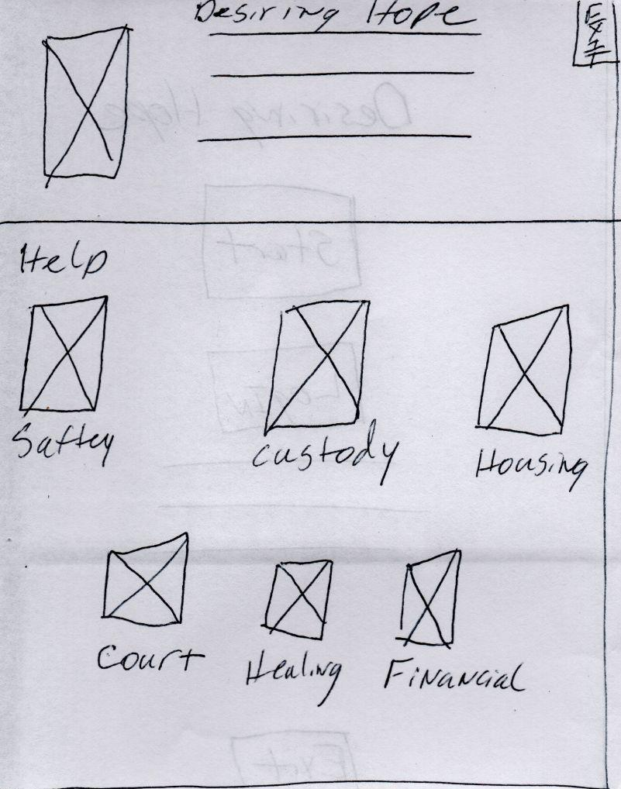
Ideation
My thoughts was how to make a dense information app/website user friendly. I decided to keep to always keep it simple. Even simplified the title from “Desiring Hope” to what the app is “DV Resources.”

Slide 12
Digital wireframes
Low-fidelity prototype
Usability studies
Starting
the design

Slide 13
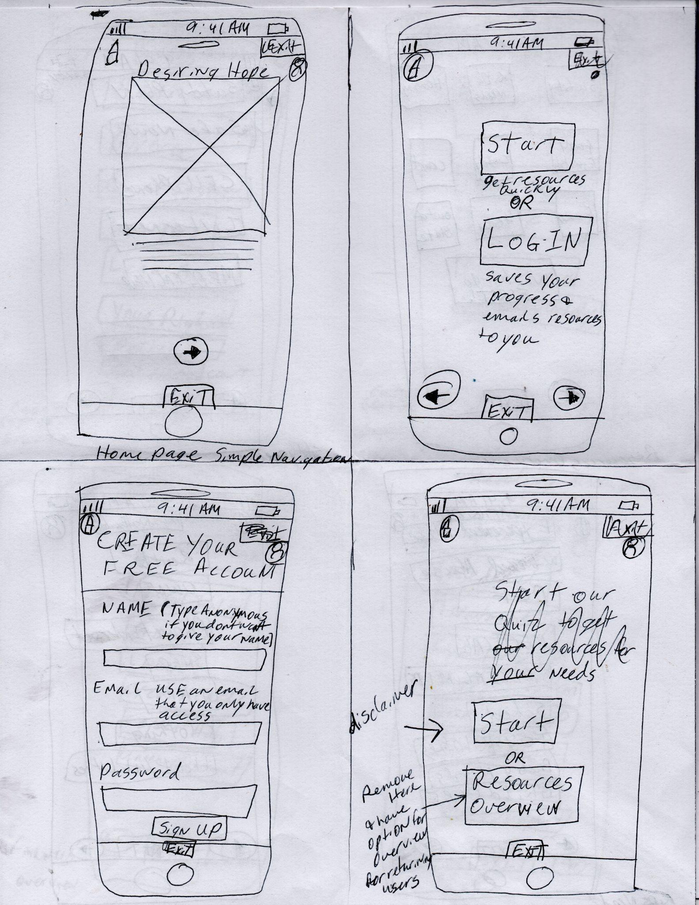
Paper and Digital wireframes
Keep it simple and keep DV survivors safe by providing quick exits and being able to use the app anonymously.
Log In is optional and can be anonymous. Logging in just saves previous searches for convenience.
At first, I was going to have a quiz to gamify the process but the decision tree was huge and confusing. It was simpler to have users direct the search.

Slide 14
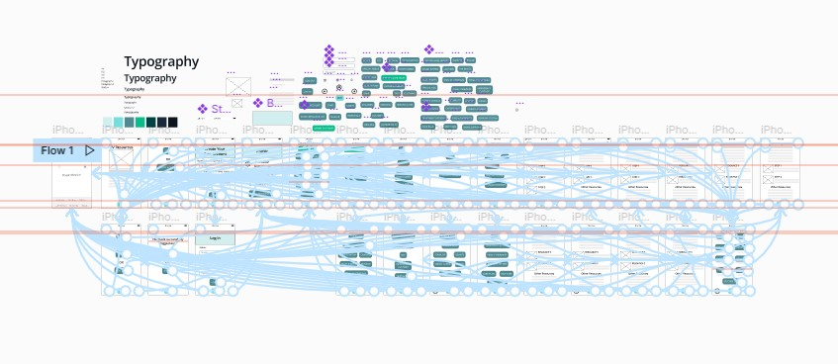
The first version did not have a complete login/logout system or a “contact us” page. These were added after completing the research study.
Low-fidelity prototype

Slide 15
Usability study: parameters
Study type:
Unmoderated usability study
Location:
Deep River, remote
Participants:
5 participants
Length:
15-20 minutes

Slide 16
Usability study: findings
1
2
3
Finding
Finding
Finding
Add a “Log In” Page that is different from “Create Account” Page.
Add a “Log Out” Page to confirm logout process.
Add a “Contact Us” Page so people could ask questions or volunteer information or time to the project.

Slide 17
Refining
the design
Mockups
High-fidelity prototype
Accessibility

Slide 18
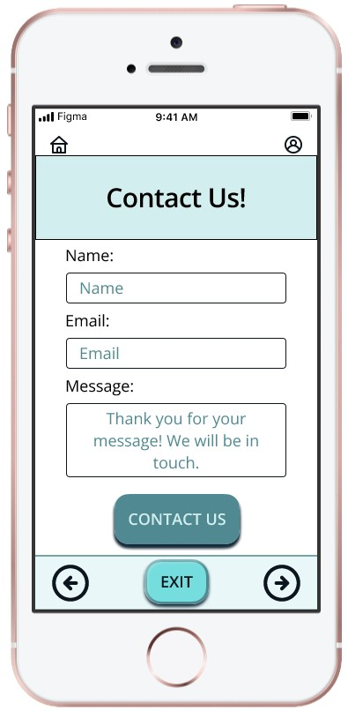
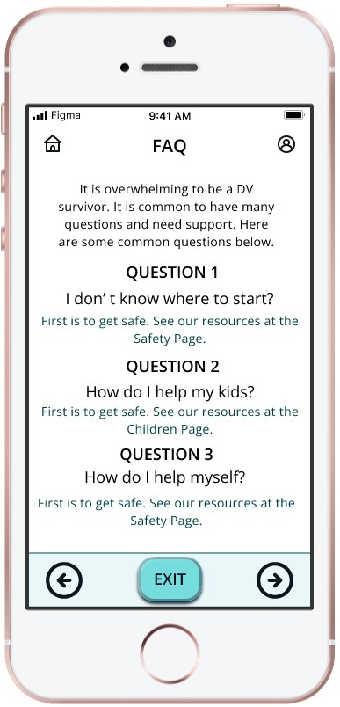
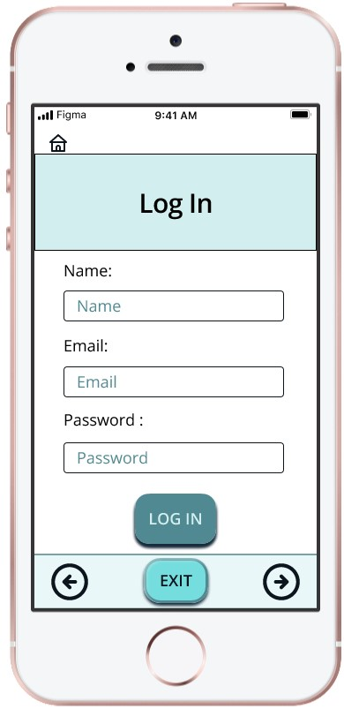
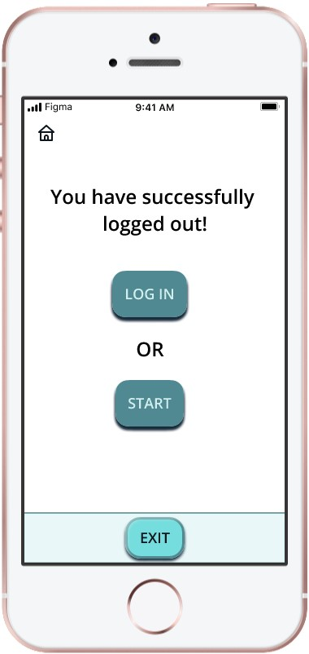
All of these screen were missing from the project. They were added after the initial usability study.
Mockups
Main mockup screen for display
Main mockup screen for display
Main mockup screen for display
Main mockup screen for display

Slide 19
High-fidelity
prototype
I wanted users to feel safe using the app so I added in the “Quick Exit” to every page. Also usability was important, so I simplified all the information into categories and allowed users to control the search. Also, there searches were saved for convenience.
Screenshot of prototype with connections or prototype GIF

Slide 20
Accessibility considerations
1
2
3
Using the “Coolers” App, I tested the color combination for all types of color blindness and other vision issues.
Understanding most users are in crisis is important. For that reason, safety planning is emphasized.
Also, being in a crisis means memory will not function normally, this is why there is a save option and you can still save and be anonymous.

Slide 21
Responsive Design
Information architecture
Responsive design

Slide 22
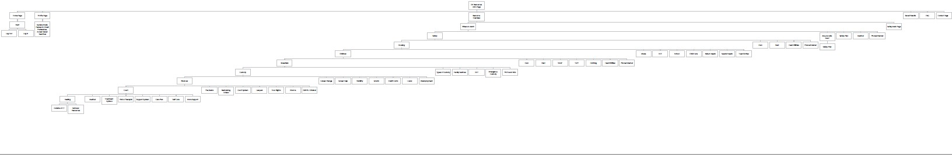
The sitemap I created shows how overwhelming the amount of information can be for users/DV survivors. Hence, the simplicity of the app/website.
Sitemap

Slide 23

Responsive designs
Main User Flow for a Mobile Website created for iPhone 11Pro Max

Slide 24
Responsive designs
Main User Flow for a Responsive Website created for iPad Pro 12.9

Slide 25
Going forward
Takeaways
Next steps

Slide 26
Takeaways
Impact:
One quote from peer feedback:
“This is going to help so many people. I am glad someone is finally doing something about this.”
Once these products are built, I believe this app/website is going to help DV survivors greatly and can be a great resource for DV professionals as well.
What I learned:
I learned with this design, I do not have to have videos and other multimedia to make a useful website. Keeping things simple is sometime the best design.

Slide 27
Next steps
1
2
3
Build an mobile app of this product.
Build a responsive website that is mobile too.
After the products are built, retest with users and iterate on the design. Continue to gather resources for DV survivors.

Slide 28
Insert a few sentences summarizing the next steps you would take with this project and why. Feel free to organize next steps in a bullet point list.
Let’s connect!
Thank you for your time! Also, thank you for reviewing my DV Resources App and Responsive Website and it’s Presentation! To learn more about me, visit my website or drop a line at my email provided below. Thank you!
Email: bobbianne.elizabeth@gmail.com
Website: www.tenacityart.com

